Slide 1
CS276: Information Retrieval and Web Search
Pandu Nayak and Prabhakar Raghavan
Lecture 6: Scoring, Term Weighting and the Vector Space Model

Slide 2
This lecture; IIR Sections 6.2-6.4.3
Ranked retrieval
Scoring documents
Term frequency
Collection statistics
Weighting schemes
Vector space scoring

Slide 3
Ranked retrieval
Ch. 6
Thus far, our queries have all been Boolean.
  Documents either match or don’t.
Good for expert users with precise understanding of their needs and the collection.
  Also good for applications: Applications can easily consume 1000s of results.
Not good for the majority of users.
  Most users incapable of writing Boolean queries (or they are, but they think it’s too much work).
  Most users don’t want to wade through 1000s of results.
    This is particularly true of web search.

Slide 4
Problem with Boolean search: feast or famine
Ch. 6
Boolean queries often result in either too few (=0) or too many (1000s) results.
Query 1: “standard user dlink 650” → 200,000 hits
Query 2: “standard user dlink 650 no card found”: 0 hits
It takes a lot of skill to come up with a query that produces a manageable number of hits.
  AND gives too few; OR gives too many

Slide 5
Ranked retrieval models
Rather than a set of documents satisfying a query expression, in ranked retrieval, the system returns an ordering over the (top) documents in the collection for a query
Free text queries: Rather than a query language of operators and expressions, the user’s query is just one or more words in a human language
In principle, there are two separate choices here, but in practice, ranked retrieval has normally been associated with free text queries and vice versa

Slide 6
Feast or famine: not a problem in ranked retrieval
Ch. 6
When a system produces a ranked result set, large result sets are not an issue
  Indeed, the size of the result set is not an issue
  We just show the top k ( ≈ 10) results
  We don’t overwhelm the user
  Premise: the ranking algorithm works

Slide 7
Scoring as the basis of ranked retrieval
Ch. 6
We wish to return in order the documents most likely to be useful to the searcher
How can we rank-order the documents in the collection with respect to a query?
Assign a score – say in [0, 1] – to each document
This score measures how well document and query “match”.

Slide 8
Query-document matching scores
Ch. 6
We need a way of assigning a score to a query/document pair
Let’s start with a one-term query
If the query term does not occur in the document: score should be 0
The more frequent the query term in the document, the higher the score (should be)
We will look at a number of alternatives for this.

Slide 9
Take 1: Jaccard coefficient
Ch. 6
Recall from Lecture 3: A commonly used measure of overlap of two sets A and B
jaccard(A,B) = |A ∩ B| / |A ∪ B|
jaccard(A,A) = 1
jaccard(A,B) = 0 if A ∩ B = 0
A and B don’t have to be the same size.
Always assigns a number between 0 and 1.

Slide 10
Jaccard coefficient: Scoring example
Ch. 6
What is the query-document match score that the Jaccard coefficient computes for each of the two documents below?
Query: ides of march
Document 1: caesar died in march
Document 2: the long march

Slide 11
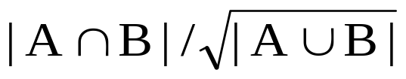
Issues with Jaccard for scoring
Ch. 6
It doesn’t consider term frequency (how many times a term occurs in a document)
Rare terms in a collection are more informative than frequent terms. Jaccard doesn’t consider this information
We need a more sophisticated way of normalizing for length
Later in this lecture, we’ll use
. . . instead of |A ∩ B|/|A ∪ B| (Jaccard) for length normalization.

Slide 12

Recall (Lecture 1): Binary term-document incidence matrix
Sec. 6.2
Each document is represented by a binary vector ∈ {0,1}^{|V|}

Slide 13
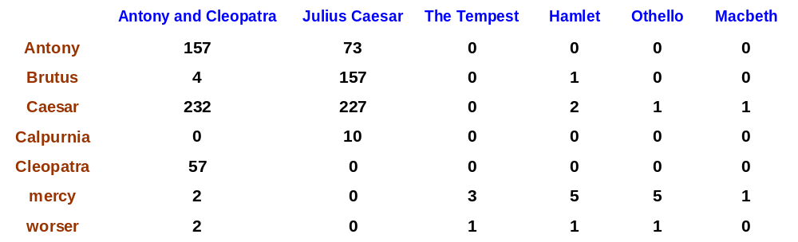
Term-document count matrices
Sec. 6.2
Consider the number of occurrences of a term in a document:
  Each document is a count vector in ℕ^{v}: a column below

Slide 14
Bag of words model
Vector representation doesn’t consider the ordering of words in a document
John is quicker than Mary and Mary is quicker than John have the same vectors
This is called the bag of words model.
In a sense, this is a step back: The positional index was able to distinguish these two documents.
We will look at “recovering” positional information later in this course.
For now: bag of words model

Slide 15
Term frequency tf
The term frequency tf_{t,d} of term t in document d is defined as the number of times that t occurs in d.
We want to use tf when computing query-document match scores. But how?
Raw term frequency is not what we want:
  A document with 10 occurrences of the term is more relevant than a document with 1 occurrence of the term.
  But not 10 times more relevant.
Relevance does not increase proportionally with term frequency.
NB: frequency = count in IR

Slide 16
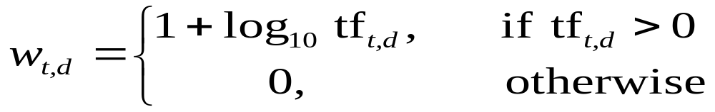

Log-frequency weighting
Sec. 6.2
The log frequency weight of term t in d is
0 → 0, 1 → 1, 2 → 1.3, 10 → 2, 1000 → 4, etc.
Score for a document-query pair: sum over terms t in both q and d:
score
The score is 0 if none of the query terms is present in the document.

Slide 17
Log-frequency weighting (Example1)
Ch. 6
What is the query-document match score that the Log-frequency weighting computes for each of the two documents below?
Query: ides of march
Document 1: caesar died in march
Document 2: the long march
Term | Document1 |  | Document2
 | tf_{t,d1} | Wt, _{d1} | tf_{t,d2} | Wt, _{d2}
ides
of
march
score

Slide 18
Document frequency
Sec. 6.2.1
Rare terms are more informative than frequent terms
  Recall stop words
Consider a term in the query that is rare in the collection (e.g., arachnocentric)
A document containing this term is very likely to be relevant to the query arachnocentric
→ We want a high weight for rare terms like arachnocentric.

Slide 19
Document frequency, continued
Sec. 6.2.1
Frequent terms are less informative than rare terms
Consider a query term that is frequent in the collection (e.g., high, increase, line)
A document containing such a term is more likely to be relevant than a document that doesn’t
But it’s not a sure indicator of relevance.
→ For frequent terms, we want high positive weights for words like high, increase, and line
But lower weights than for rare terms.
We will use document frequency (df) to capture this.

Slide 20
Log-frequency weighting (Example2)
Ch. 6
What is the query-document match score that the Log-frequency weighting computes for each of the two documents below?
Query: Is Mars a planet?
Document 1: Mars is the fourth planet from the Sun and the second smallest planet in the Solar System.
Document 2: Have you ever wondered what it would be like to walk around on Mars planet?. Mercury is the smallest terrestrial planet (and smallest planet) in the Solar System.

Slide 21

Term | Document1 |  | Document2
 | tf_{t,d1} | Wt, _{d1} | tf_{t,d2} | Wt, _{d2}
Is | 1 |  | 1
Mars | 1 |  | 1
a | 0 |  | 0
planet | 2 |  | 3
score

Slide 22
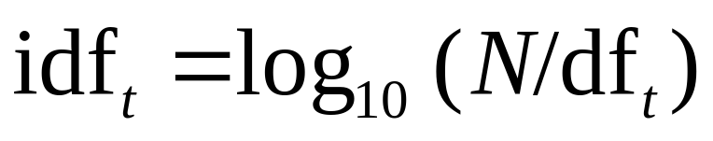
idf weight
Sec. 6.2.1
df_{t} is the document frequency of t: the number of documents that contain t
  df_{t} is an inverse measure of the informativeness of t
  df_{t} ≤ N
We define the idf (inverse document frequency) of t by
  We use log (N/df_{t}) instead of N/df_{t} to “dampen” the effect of idf.

Slide 23
idf example, suppose N = 1 million
Sec. 6.2.1
term | df_{t} | idf_{t}
calpurnia | 1 | 6
animal | 100 | 4
sunday | 1,000 | 3
fly | 10,000 | 2
under | 100,000 | 1
the | 1,000,000 | 0
There is one idf value for each term t in a collection.
Notes:
6 4 3 2 1 0

Slide 24
Effect of idf on ranking
Does idf have an effect on ranking for one-term queries, like
  iPhone
idf has no effect on ranking one term queries
  idf affects the ranking of documents for queries with at least two terms
  For the query capricious person, idf weighting makes occurrences of capricious count for much more in the final document ranking than occurrences of person.

Slide 25
Collection vs. Document frequency
Sec. 6.2.1
The collection frequency of t is the number of occurrences of t in the collection, counting multiple occurrences.
Example:
Which word is a better search term (and should get a higher weight)?
The number of documents that contain t
Word | Collection frequency | Document frequency
insurance | 10440 | 3997
try | 10422 | 8760
Notes:
Why do you get these numbers?
Suggests df is better.

Slide 26
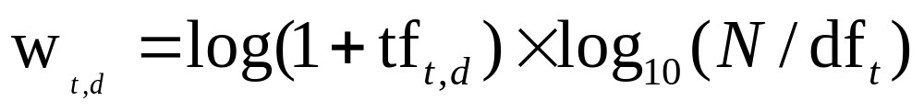
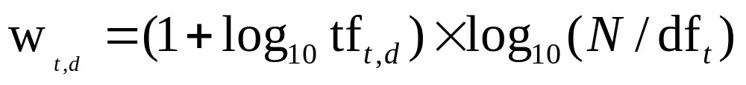
tf-idf weighting
Sec. 6.2.2
The tf-idf weight of a term is the product of its tf weight and its idf weight.
Best known weighting scheme in information retrieval
  Note: the “-” in tf-idf is a hyphen, not a minus sign!
  Alternative names: tf.idf, tf x idf
Increases with the number of occurrences within a document
Increases with the rarity of the term in the collection

Slide 27
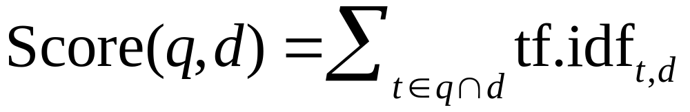
Score for a document given a query
Sec. 6.2.2
There are many variants
  How “tf” is computed (with/without logs)
  Whether the terms in the query are also weighted
  …

Slide 28

Binary → count → weight matrix
Sec. 6.3
Each document is now represented by a real-valued vector of tf-idf weights ∈ R^{|V|}
Notes:
number of occurrences

Slide 29
Documents as vectors
Sec. 6.3
So we have a |V|-dimensional vector space
Terms are axes of the space
Documents are points or vectors in this space
Very high-dimensional: tens of millions of dimensions when you apply this to a web search engine
These are very sparse vectors - most entries are zero.

Slide 30
Queries as vectors
Sec. 6.3
Key idea 1: Do the same for queries: represent them as vectors in the space
Key idea 2: Rank documents according to their proximity to the query in this space
proximity = similarity of vectors
proximity ≈ inverse of distance
Recall: We do this because we want to get away from the you’re-either-in-or-out Boolean model.
Instead: rank more relevant documents higher than less relevant documents

Slide 31
Formalizing vector space proximity
Sec. 6.3
First cut: distance between two points
  ( = distance between the end points of the two vectors)
Euclidean distance?
Euclidean distance is a bad idea . . .
. . . because Euclidean distance is large for vectors of different lengths.

Slide 32

Why distance is a bad idea
Sec. 6.3
The Euclidean distance between q
and d₂ is large even though the
distribution of terms in the query q and the distribution of
terms in the document d₂ are
very similar.

Slide 33
Use angle instead of distance
Sec. 6.3
Thought experiment: take a document d and append it to itself. Call this document d′.
“Semantically” d and d′ have the same content
The Euclidean distance between the two documents can be quite large
The angle between the two documents is 0, corresponding to maximal similarity.
Key idea: Rank documents according to angle with query.

Slide 34
From angles to cosines
Sec. 6.3
The following two notions are equivalent.
  Rank documents in decreasing order of the angle between query and document
  Rank documents in increasing order of cosine(query,document)
Cosine is a monotonically decreasing function for the interval [0º, 180º]
Notes:
Cos(0)=1
Cos(90)=0
Cos(180)=-1

Slide 35
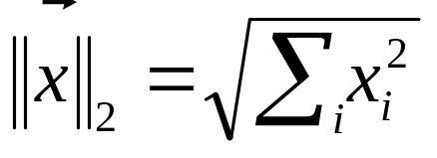
Length normalization
Sec. 6.3
A vector can be (length-) normalized by dividing each of its components by its length – for this we use the L₂ norm:
Dividing a vector by its L₂ norm makes it a unit (length) vector (on surface of unit hypersphere)
Effect on the two documents d and d′ (d appended to itself) from earlier slide: they have identical vectors after length-normalization.
  Long and short documents now have comparable weights

Slide 36

cosine(query,document)
Sec. 6.3
Dot product
Unit vectors
q_{i} is the tf-idf weight of term i in the query
d_{i} is the tf-idf weight of term i in the document
cos(q,d) is the cosine similarity of q and d … or,
equivalently, the cosine of the angle between q and d.
Notes:
See Law of Cosines (Cosine Rule) wikipedia page

Slide 37
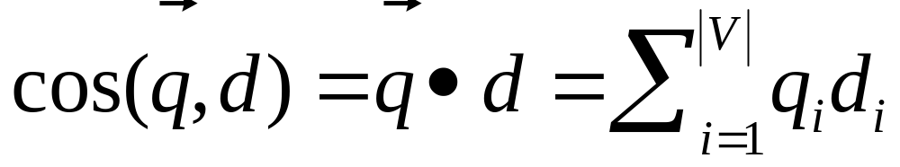
Cosine for length-normalized vectors
For length-normalized vectors, cosine similarity is simply the dot product (or scalar product):
for q, d length-normalized.

Slide 38

Cosine similarity illustrated

Slide 39
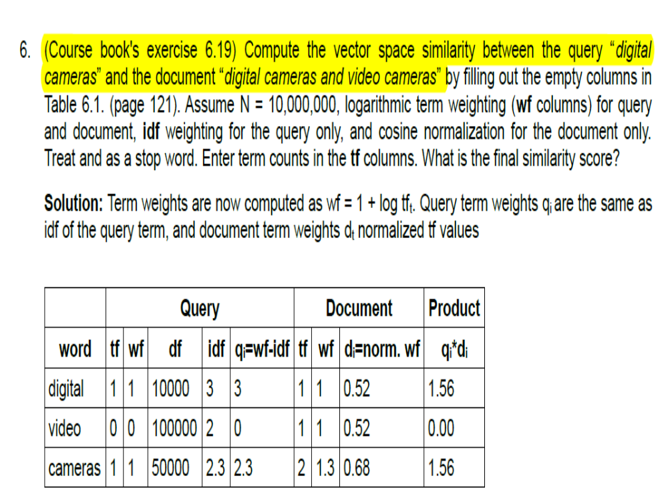
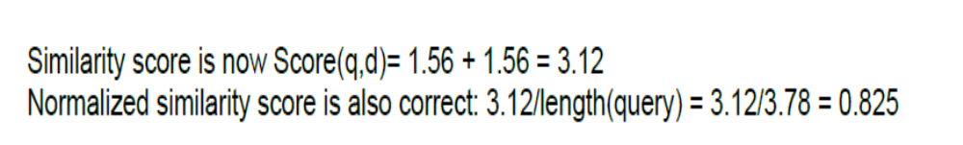

Slide 40
Cosine similarity amongst 3 documents
Sec. 6.3
How similar are
the novels
SaS: Sense and
Sensibility
PaP: Pride and
Prejudice, and
WH: Wuthering
Heights?
term | SaS | PaP | WH
affection | 115 | 58 | 20
jealous | 10 | 7 | 11
gossip | 2 | 0 | 6
wuthering | 0 | 0 | 38
Term frequencies (counts)
Note: To simplify this example, we don’t do idf weighting.

Slide 41
3 documents example contd.
Sec. 6.3
Log frequency weighting
After length normalization
term | SaS | PaP | WH
affection | 3.06 | 2.76 | 2.30
jealous | 2.00 | 1.85 | 2.04
gossip | 1.30 | 0 | 1.78
wuthering | 0 | 0 | 2.58
term | SaS | PaP | WH
affection | 0.789 | 0.832 | 0.524
jealous | 0.515 | 0.555 | 0.465
gossip | 0.335 | 0 | 0.405
wuthering | 0 | 0 | 0.588
cos(SaS,PaP) ≈
0.789 × 0.832 + 0.515 × 0.555 + 0.335 × 0.0 + 0.0 × 0.0
≈ 0.94
cos(SaS,WH) ≈ 0.79
cos(PaP,WH) ≈ 0.69

Slide 42

Computing cosine scores
Sec. 6.3

Slide 43

tf-idf weighting has many variants
Sec. 6.4
Why is the base of the log in idf immaterial(unimportant)?

Slide 44

tf-idf example: lnc.ltc
Sec. 6.4
Term | df
Computing | 10000
cosine | 50000
scores | 10000
N = 1 million
Document: Computing cosine scores
Query: cosine scores
Term | Query |  |  |  |  |  | Document |  |  |  | Prod
 | tf-raw | tf-wt | df | idf | wt tf-idf | n’lize | tf-raw | tf-wt | wt | n’lize
auto | 0 | 0 | 5000 | 2.3 | 0 | 0 | 1 | 1 | 1 | 0.52 | 0
best | 1 | 1 | 50000 | 1.3 | 1.3 | 0.34 | 0 | 0 | 0 | 0 | 0
car | 1 | 1 | 10000 | 2.0 | 2.0 | 0.52 | 1 | 1 | 1 | 0.52 | 0.27
insurance | 1 | 1 | 1000 | 3.0 | 3.0 | 0.78 | 2 | 1.3 | 1.3 | 0.68 | 0.53
Doc length =
Score = 0+0+0.27+0.53 = 0.8
Notes:
inverse document frequency

Slide 45
tf-idf example: lnc.ltc
Sec. 6.4
N = 1 million
Term | df
auto | 5000
best | 50000
car | 10000
insurance | 1000
Document: car insurance auto insurance
Query: best car insurance
Term | Query |  |  |  |  |  | Document |  |  |  | Prod
 | tf-raw | tf-wt | df | idf | wt tf-idf | n’lize | tf-raw | tf-wt | wt | n’lize
auto | 0 | 0 | 5000 | 2.3 | 0 | 0 | 1 | 1 | 1 | 0.52 | 0
best | 1 | 1 | 50000 | 1.3 | 1.3 | 0.34 | 0 | 0 | 0 | 0 | 0
car | 1 | 1 | 10000 | 2.0 | 2.0 | 0.52 | 1 | 1 | 1 | 0.52 | 0.27
insurance | 1 | 1 | 1000 | 3.0 | 3.0 | 0.78 | 2 | 1.3 | 1.3 | 0.68 | 0.53
Doc length =
Score = 0+0+0.27+0.53 = 0.8
Notes:
inverse document frequency

Slide 46
tf-idf example: lnc.ltc
Sec. 6.4
N = 1 million
Document: to be or not to be
Query: you have to be
Notes:
inverse document frequency

Slide 47
Summary – vector space ranking
Represent the query as a weighted tf-idf vector
Represent each document as a weighted tf-idf vector
Compute the cosine similarity score for the query vector and each document vector
Rank documents with respect to the query by score
Return the top K (e.g., K = 10) to the user

Slide 48
Resources for today’s lecture
Ch. 6
IIR 6.2 – 6.4.3

